Slide 1
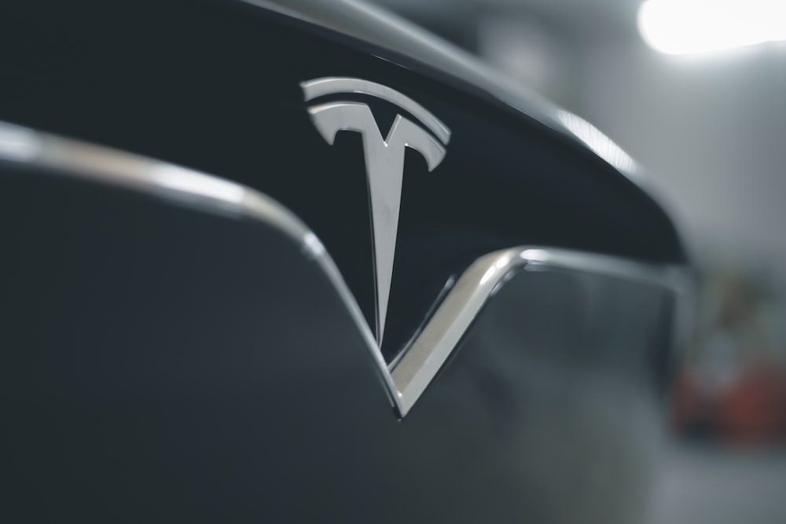
Tesla In Indian Market
OBJECTIVE
Tesla in Indian Market : Derive Strategies to be Profitable

Slide 2
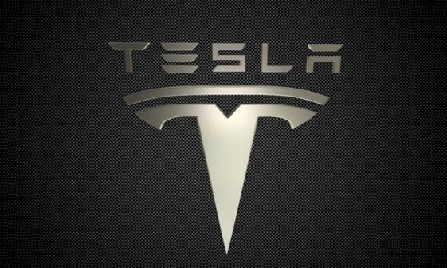
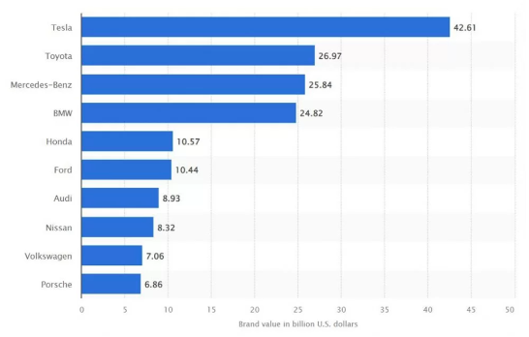
Current Scenario -World
Tesla-biggest multinational Automotive company(EV) in the world.
Tesla's market cap-
$840 B (6th most valuable company in the world)
The market position of Tesla–

Slide 3

POLITICAL FACTORS
US Government incentives for EVs-Tesla enjoys incentives worth $7500.00 tax credits to every buyer of a new EV by the US government, with a cap of 200,000+ deliveries of EVs in the US.
International trade agreements- Tesla has been hit by the trade war b/w the US and China under the Trump administration to a considerable extent
ECONOMIC FACTORS
Currency exchange rates - Due to changes in exchange rates Tesla had foreign currency transaction gains of USD 334 million in 2020.
Tax rates-Tesla benefits from Govt. tax zero Emission Vehicle (ZEV) credits apart from incentives provided to electric car manufacturers to a certain extent.
Decreasing costs of batteries- According to estimations by Bloomberg New Energy Finance report, the current price of USD137 per kilowatt-hour for lithium-ion will drop as low as USD 100 per kWh by 2023.
Decreasing renewable energy costs (opportunity).
SOCIAL FACTORS
Increasing awareness of climate change and a sustainable environment boosts customers’ demand and makes the EV market more attractive for Tesla Motors.
-Tesla’s biggest strength lies. The cars are marketed as environmentally friendly because it uses electricity more than gas.

Slide 4
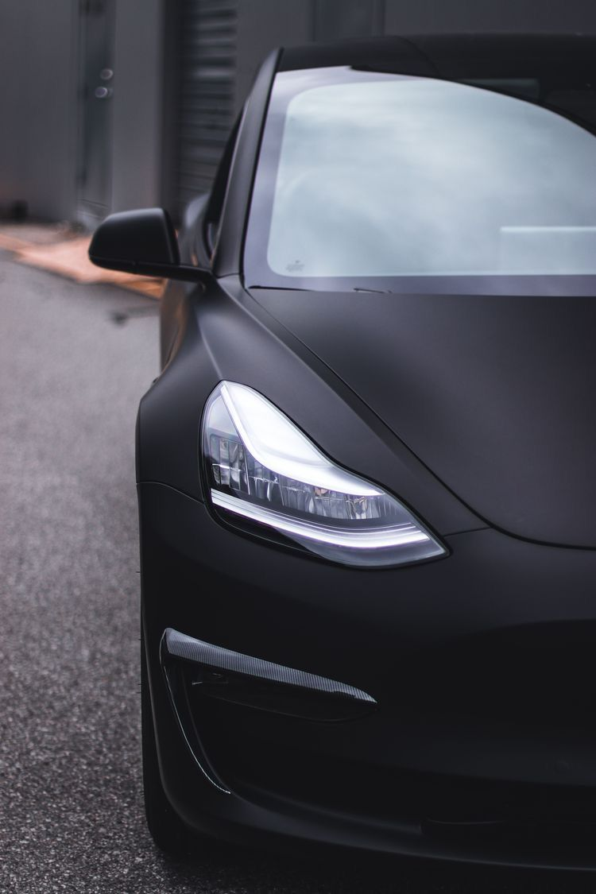
Current Scenario -India
Barrier to entry
Musk's issue with the Govt. of India
Govt. wants Tesla to set up a base in India and sell locally and export, Musk insists on slashing import duty 1st.
India levies a 60% import tax on EV’s priced $40,000 or less & 100% on those priced above $40,000. Tesla's market starts at $44,000(approx. Rs.34 lakh) in the US and selling in India with 100% import tax makes it around Rs. 60 lakh for a car.
Market rivalry
Tesla's Competitors in the world include direct competitors - Ford, General Motors, NIO, and Volkswagen
Indirect competitors- Uber and Google
Some of Tesla's competitors in India are - Tata Electric, Hyundai, Mahindra Electric, Morrison Garages India, and Mercedes Ben.

Slide 5

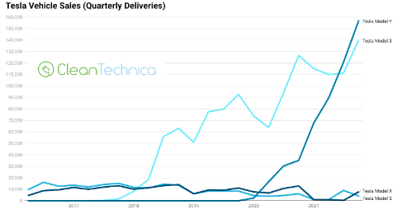
UNIQUE BUSINESS INSIGHTS
TESLA’S CUSTOMER ANALYSIS
Tesla's target market segmentation - is highly educated professionals and families with solid incomes
The US is by far the biggest consumer segment for Tesla, nearly 50% of the total worldwide sales for the brand in 2021.
TESLA’S PRODUCT ANALYSIS
Tesla's brand communication focuses on the user experience.
Tesla positions itself not just as a car, but as a lifestyle and philosophy that extends to every aspect of the customer relationship, including its Tesla Centers, better sales, and service experience for customers.
It sells the Model Y, Model 3, Model X, Model S, Cyber truck, Tesla Semi, and Tesla Roadster vehicles.
TM’s Model Y & 3 is the EV with the highest performance in the EV market, putting TM in a very competitive position.

Slide 6

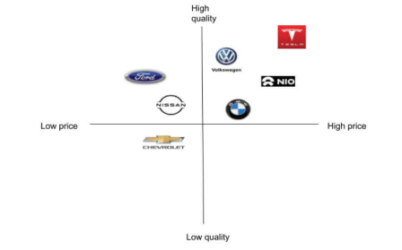
TESLA POSITIONING ANALYSIS
TESLA’S BUSINESS MODEL
Is based on direct sales and service, not franchised dealerships, keeping control over sales and service, and bringing compelling EVs to the market
It is based on a three approach to selling, servicing, and charging EVs.
pays particular attention to rolling out charging stations. That may be the biggest obstacle to the mass adoption of electric vehicles.
tax incentives promote the use of EVs and thus demand TM’s products.

Slide 7

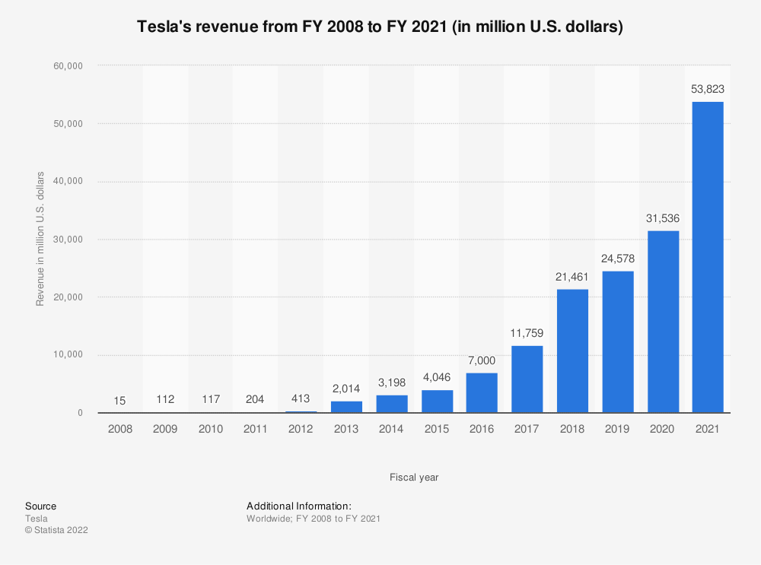
TESLA’S REVENUE MODEL
Tesla's revenue for 12 months ending June 2022, was $67.166B, a 60.45% increase year-over-year. Tesla's annual revenue for 2021 was $53.823B, a 70.67% increase from 2020.
The company delivered almost 1M EVs in 2021, and it projects to reach 1.5 M cars delivered in 2022.

Slide 8
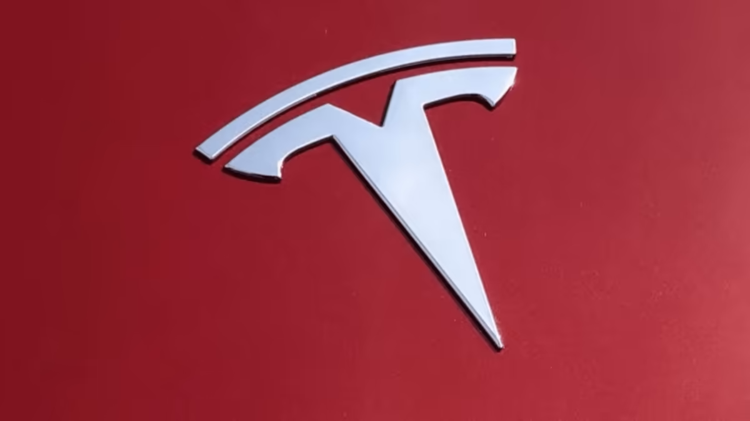
HOW TESLA CAN ENTER INDIA?
1) PLI(Production Linked Incentive) scheme- Centre approved Rs 26,058 crore for EV space to boost domestic manufacturing.
Tesla can set up a shop in India to manufacture EVs under the PLI window.
2) demand incentives provided by Govt. under the FAME II scheme.
3) Tax incentives.
The govt. has revised GST for Indian EV makers to 5% as compared to the 29-50% range applicable for internal combustion engine vehicles. The govt. the focus right now is made in India and not imported into India.
4) Red Carpet- 4 states i.e. Telangana, Maharashtra, Punjab, and West Bengal have offered the red carpet welcome to Musk, be it infrastructure, sustainability, or a streamlined approval process.

Slide 9
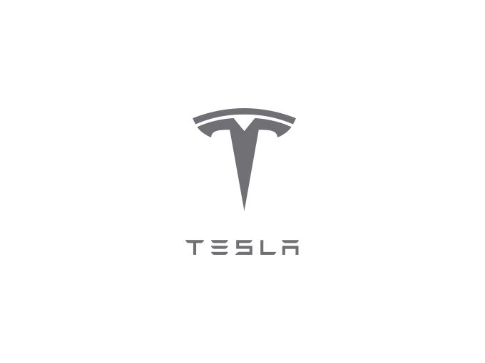
MUSK'S PROBLEM IS SIMILAR TO APPLE’S, Now Apple has captured 1/3rd of the market share in the premium segment of smartphones in India. Apple started by locally assembling and manufacturing in India dedicating fully to Make in India
ESTIMATED MARKET SIZE
India's EV market is expected to grow at a CAGR of 49% between 2021-2030 and reach annual sales of 17 million units with almost 15 million of these projected to be electric two-wheelers,(According toIBEF, Govt. of India)
There are a total of 13, 92,265 EVs on Indian roads as on August 2022 (data by Ministry of Road Transport and Highways, India). By 2030, this will likely increase by 45–50 Mn EVs on the road.
COMPETITORS IN THE MARKET
Tata market share of 71%, (with models, Nexon and Tigor EV).
MG Motors 2nd position and offers the longest-range EV.
Tata Motors' cheapest EV model, Tata Tigor EV starts at around Rs 9 lakhs while the Model 3 without any customs duty starts at Rs 30 lakhs (US$ 39,990).
Where Tesla does pose a threat though, is the luxury market. Among luxury brands, the company's position appears to be getting stronger as demand for EVs grows.
In India, it could give tough competition to Mercedes Benz, BMW, Jaguar Land Rover, and Audi.

Slide 10
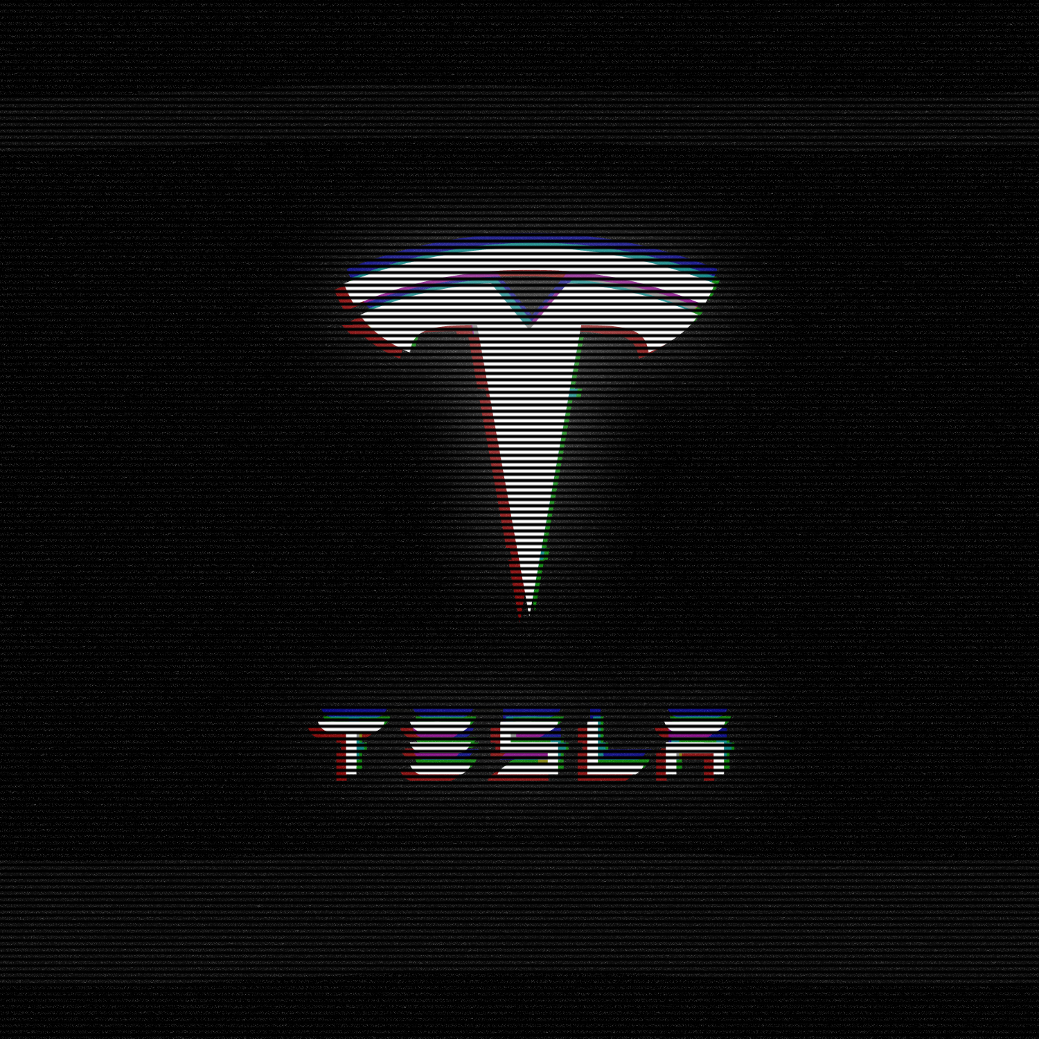
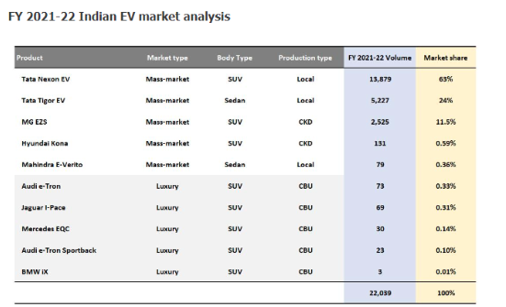
Tata commands 87% of the total EV market, followed by MG’s 11% share
Hyundai and Mahindra with one product each remained fringe players
Luxury EV accounts for 0.9% of the total EV market

Slide 11

BUSINESS DECISIONS TO MAKE TESLA PROFITABLE
By population approach, we calculated no. of EV cars in India.
Which is 3mn.
From guesstimate it is possible that tesla can capture market of 10% medium price range and 50% from luxury E.V market .So , total of 15% from all the E.V market.
BREAKEVEN PERIOD
Breakeven point is the estimation of when can be a business is profitable. So, according to IBEF estimated no.of E.V will be around 40-50 million by 2030.it is a 30 times growth .so , tesla can recover there investment in around 3-4 years of time.

Slide 12
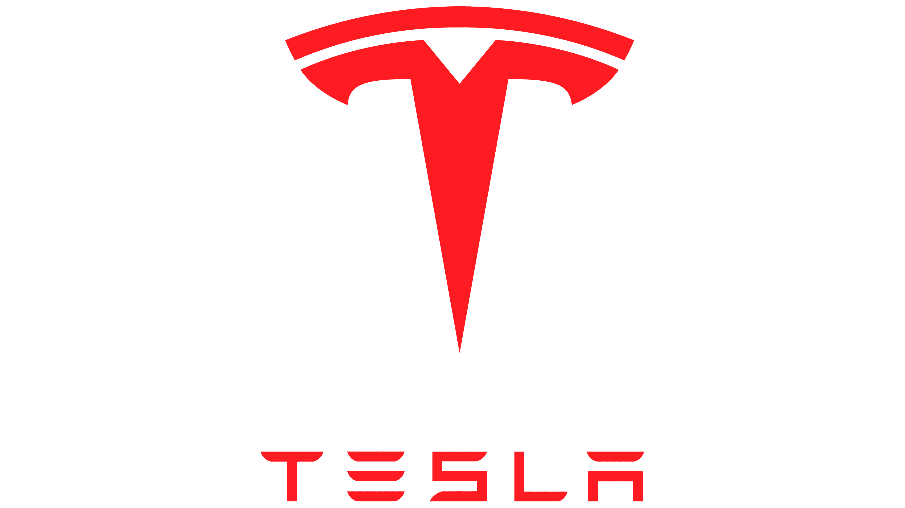
Guesstimate Approach
Population
1.4B
Rural(70%)
980M
Urban(30%)
420M
Pop.
EWC+LMC
40%(400M)
MC
50%(500M)
UC
10%(100M)
EWC+LMC
30%(120M)
MC
50%(200M)
UC
20%(80M)
70%
70M
10%
12M
20%
40M
70%
56M
Veh.
Pop.
10%
40M
20%
100M

Slide 13
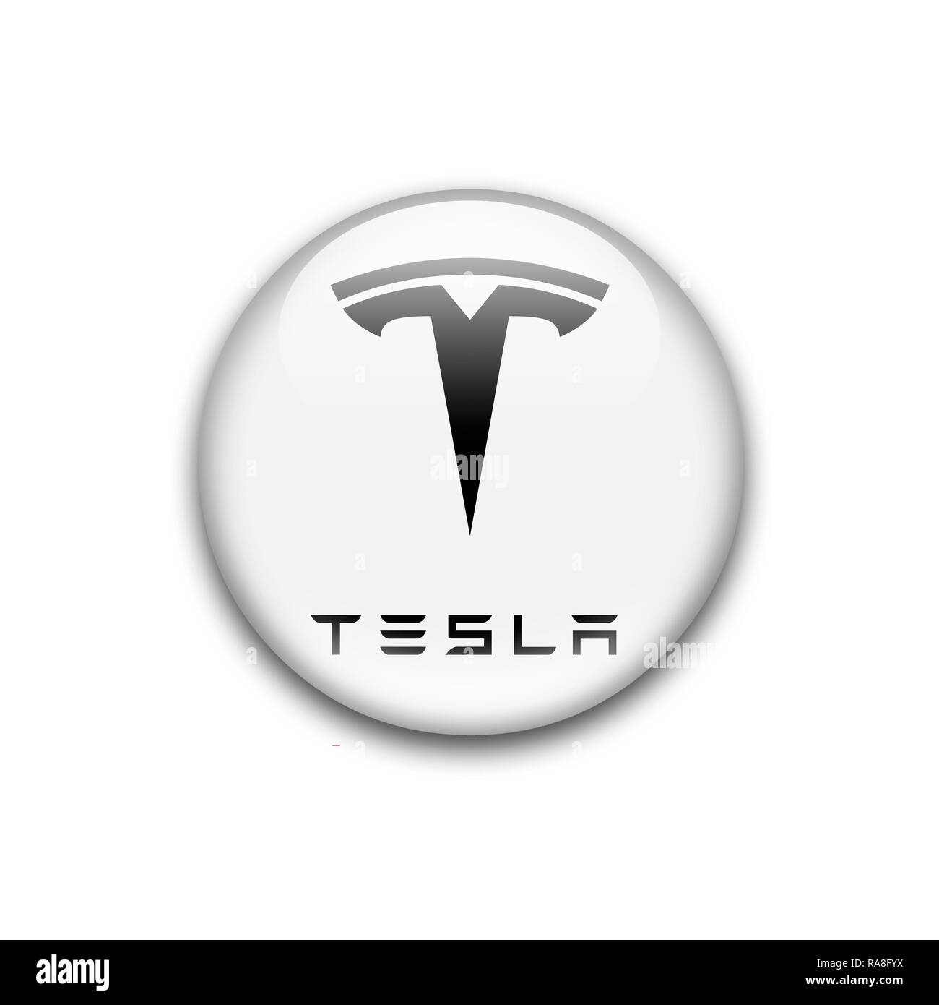
Guesstimate Approach
Vehicle
320M
Fuel Based
90%(290M)
Electric Based
10%(30M)
2 W
60%(18M)
3 W
30%(9M)
4 W
10%(3M)
No. of Wheels(W)
Price cap
Lakh(L)
Medium(10-20L)
50%(150K)
Luxury(>20L)
20%(60K)
Normal(<10L)
30%(90K)
Tesla can aquire
15%(45K*100%/300k)
Medium cap
10%(15K)
Luxuary
50%(30K)

Slide 14

RISK ASSOCIATED
India is lacking behind in terms of infrastructure .so , for tesla it will be a big responsibility to set up charging points all over India .
2) As all we know Tata and Mahindra are already in E.V market in India and they have very good brand reputation .so, for tesla that can be risk to compete against that.

Slide 15
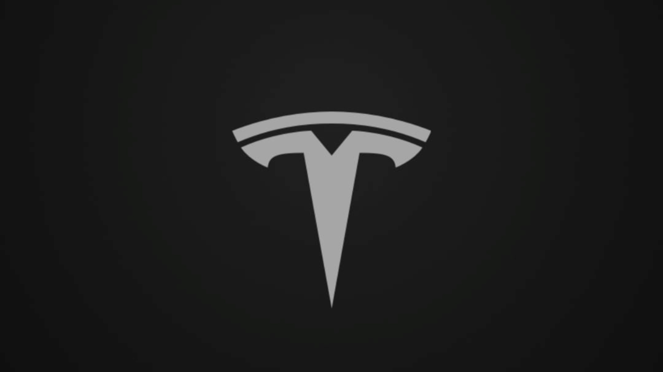
CONCLUSION
Brand reputation of tesla in world can help tesla to acquire 10 % market share of medium E.V and 50 % market share in Luxury E.V.
Tesla can acquire of overall of 15 % in 4 wheeler E.V market of both medium and luxury E.V market.
If tesla invest now in India ( through made in India ) then they can recover their investment in 3-4 years.

Slide 16



MEET THE TEAM
Tarun Kumar Sharma
pd15_006
ANURAG PANDEY
pd15_307
ADITYA SARKAR
PD15_128

